Slide 1
Docker - Creating a Production-grade workflow
Hung.Tran

Slide 2
CONTENT
Workflow
Build react application
Docker volumes
Auto reload after if a code change
Run test
Implement multi-step build
Running Nginx

Slide 3
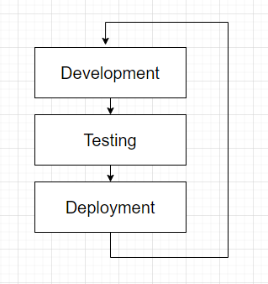
Workflow

Slide 4
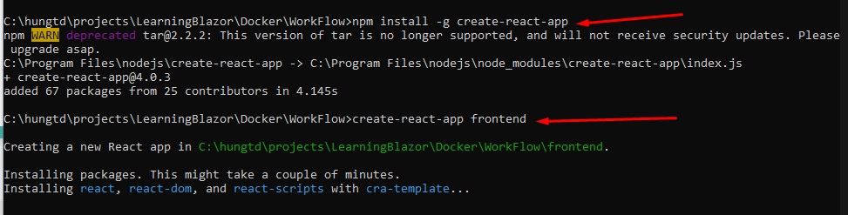
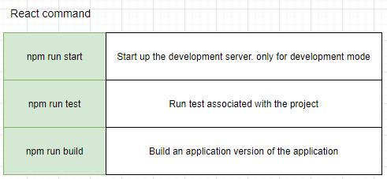
Create react app
NodeJs is required
Create React Application

Slide 5
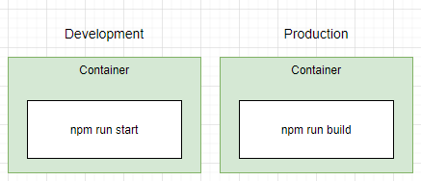
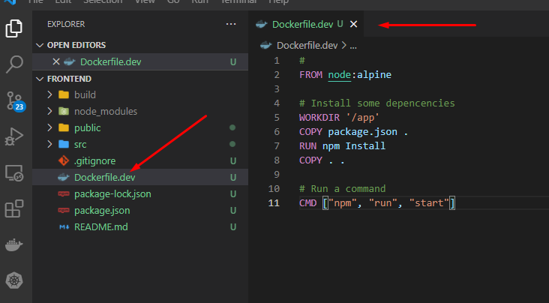
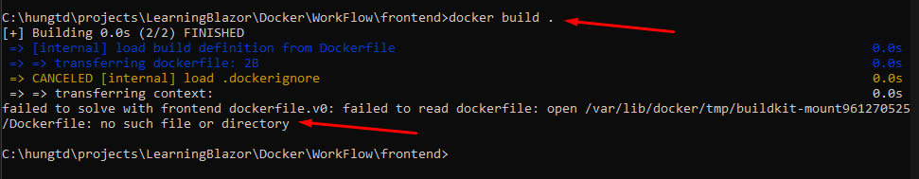
Build and run the app
The error show becuase the Dockerfile not found in the current directory

Slide 6
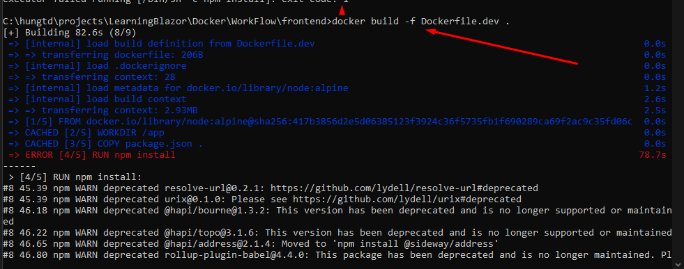
Build and run the app
-f: Try to specify the file we use to build an image

Slide 7
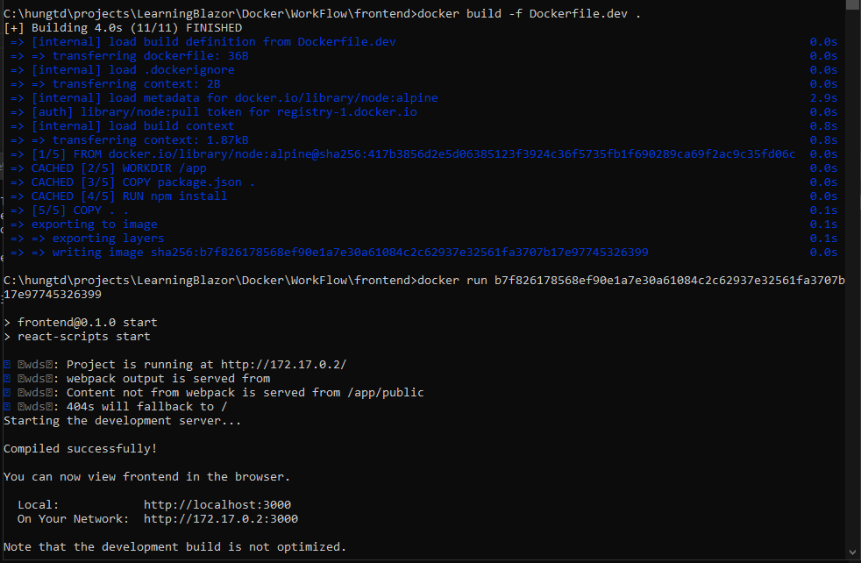
Build and run the app
To make re-build faster, We should remove node-modules folder before start to rebuild

Slide 8
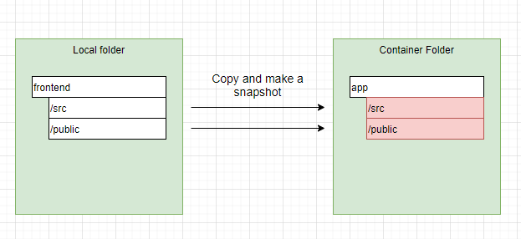
Docker volumes
Currently, When build and run a container, It will copy the file to temporary folder and taking a snapshot which locked and can’t be change when we have some updates

Slide 9
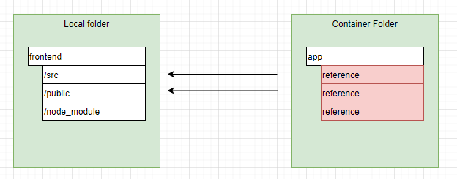
Docker volumes
Docker volumes set up a placeholder inside a Docker Container and make a references address to the current sources on the local machine

Slide 10
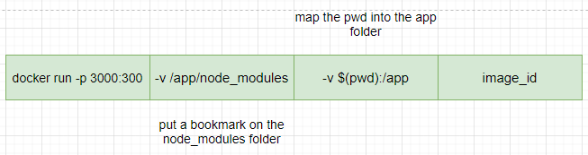
Docker volumes
pwd: is a command on linux to return the current path
The container will use the node_modules folder that it generated by itself when the Dockerfile executed the npm install. The bookmarking protects this from being overwriten

Slide 11
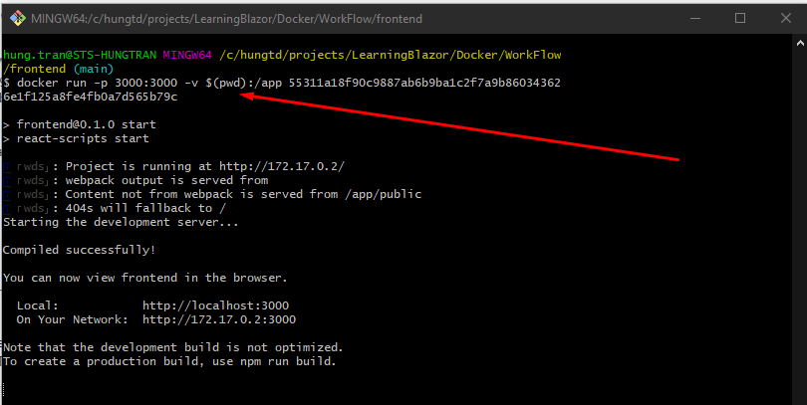
Docker volumes
pwd: is a command on linux to return the current path

Slide 12
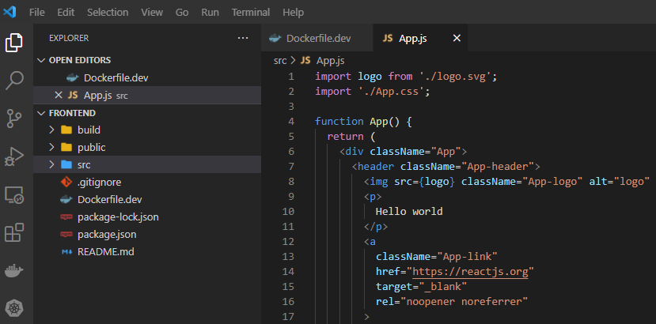
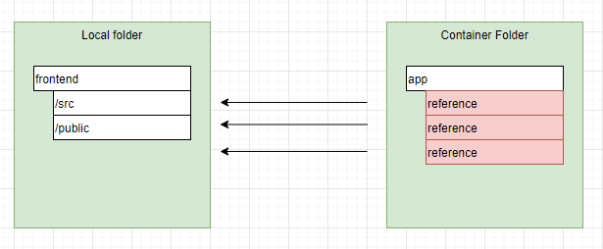
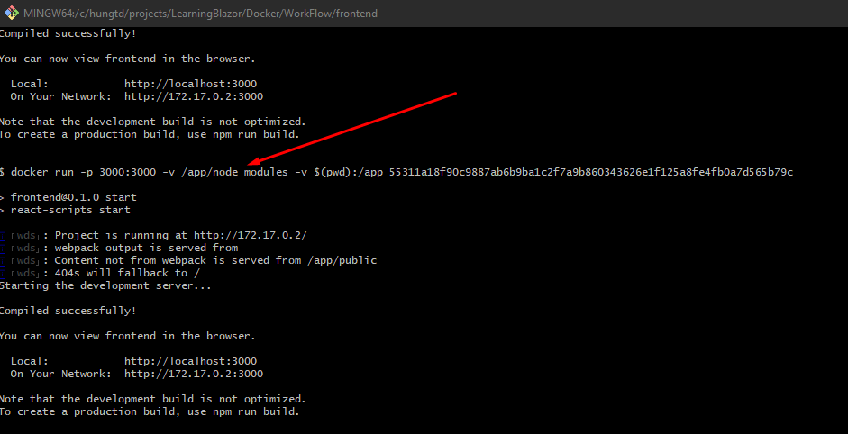
Docker volumes
node_modules folder deleted
-v /app/node_modules
Try to map with the local folder without node_modules folder because it settup when run npm install

Slide 13
Docker volumes
pwd: is a command on linux to return the current path

Slide 14
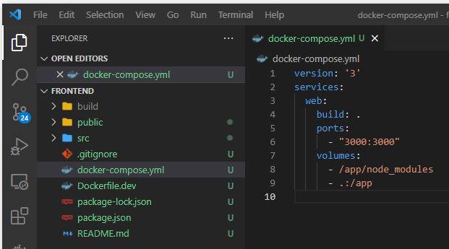
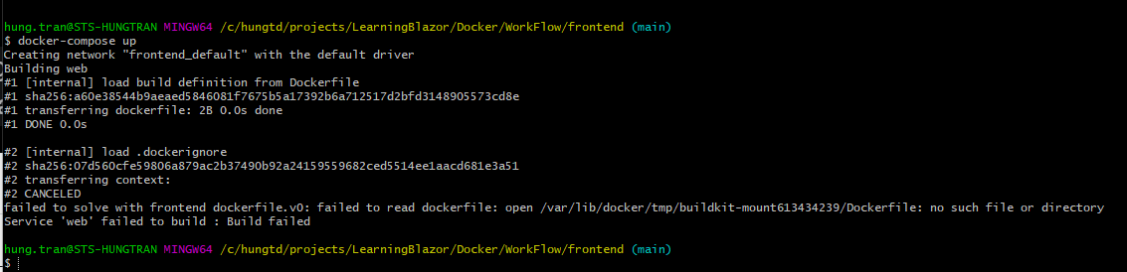
Docker compose
pwd: is a command on linux to return the current path
Notes:
Return an error because it not found any Dockerfile

Slide 15
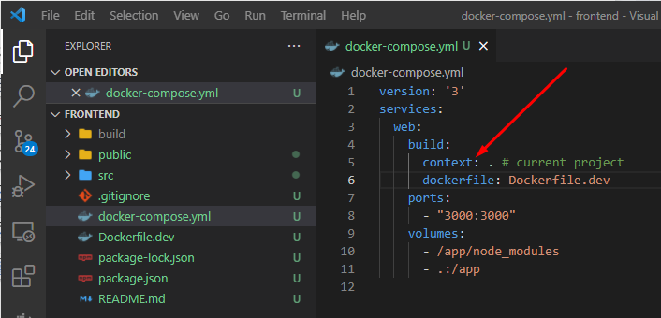
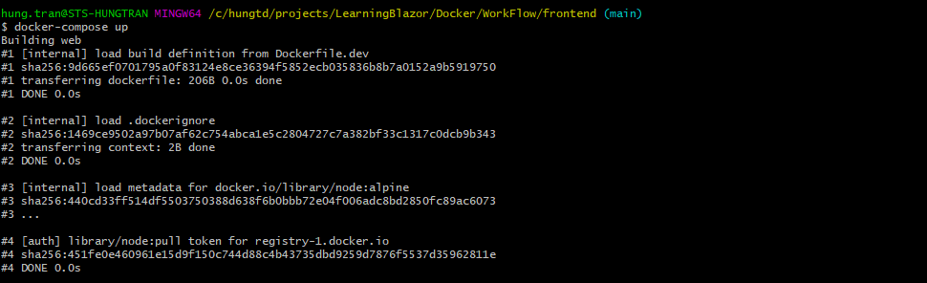
Docker compose

Slide 16
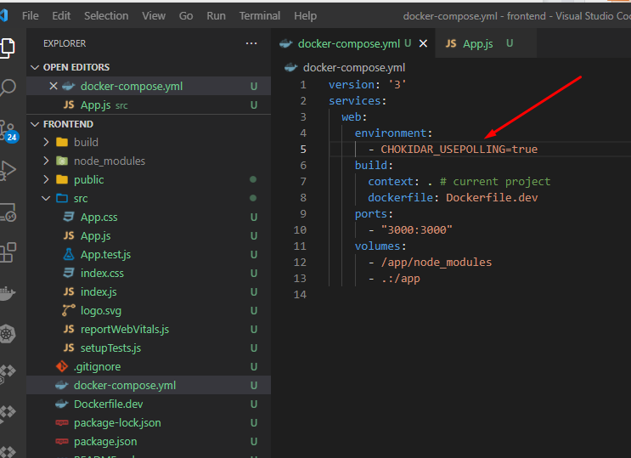
Auto update Docker Compose
CHOKIDAR_USEPOLLING=true, to setup the auto update if you run on window and your react app not automatically reload after a code change

Slide 17
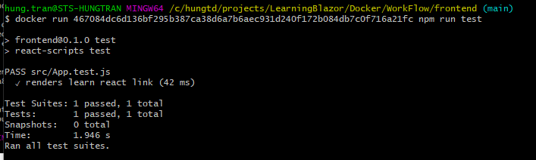
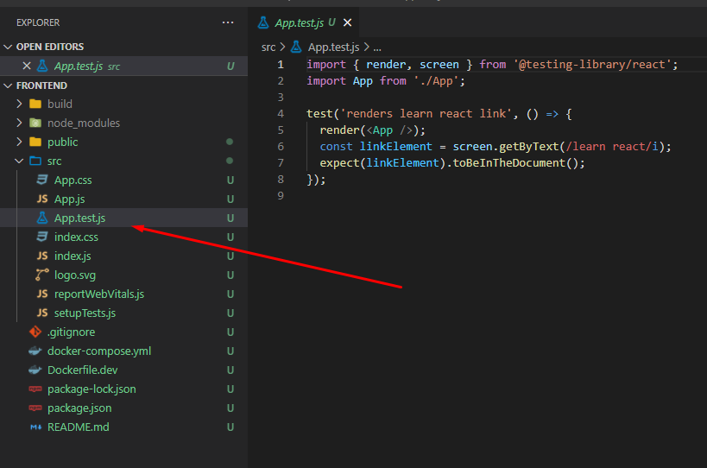
Run a test
docker run <image_id> npm run test
When we run a test, if we add more cases into the App.test.js files, it will not effect to the command line

Slide 18
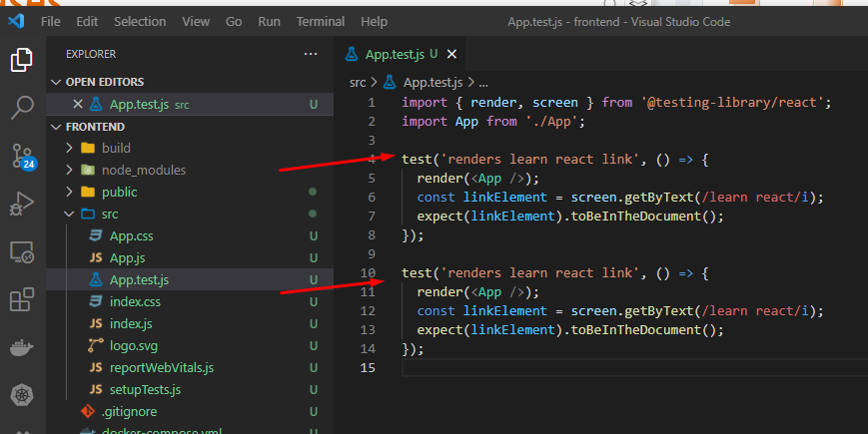
Run a test - Auto update testcases

Slide 19
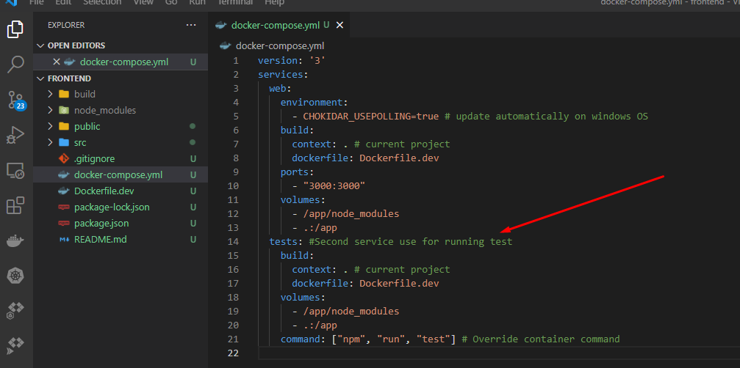
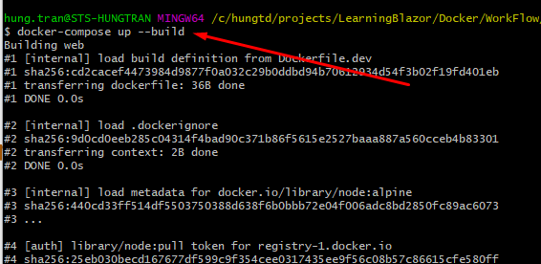
Docker compose for running testing

Slide 20
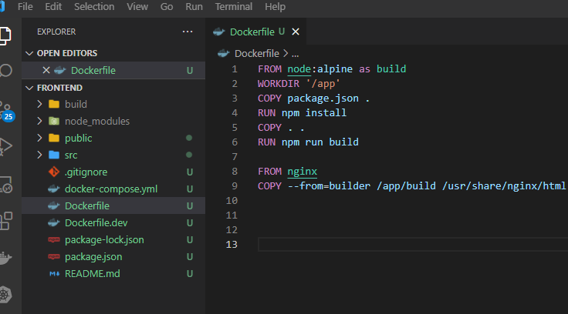
Implementing multi-step build

Slide 21
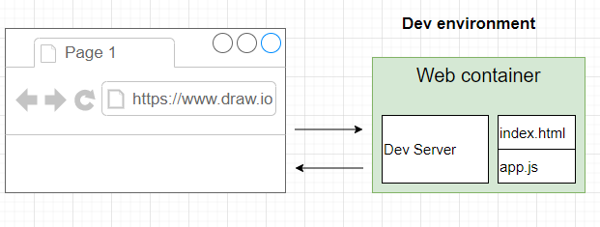
Running Nginx

Slide 22
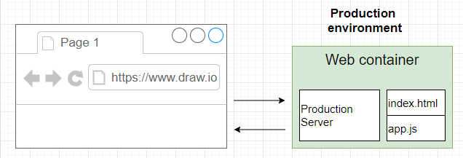
Running Nginx

Slide 23
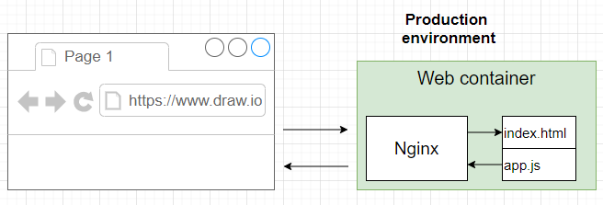
Running Nginx

Slide 24
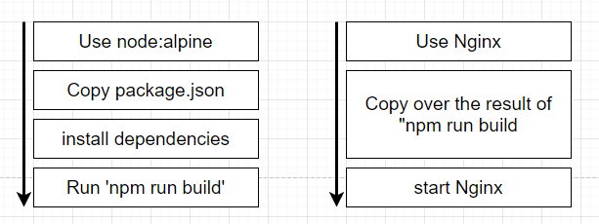
Running Nginx

Slide 25
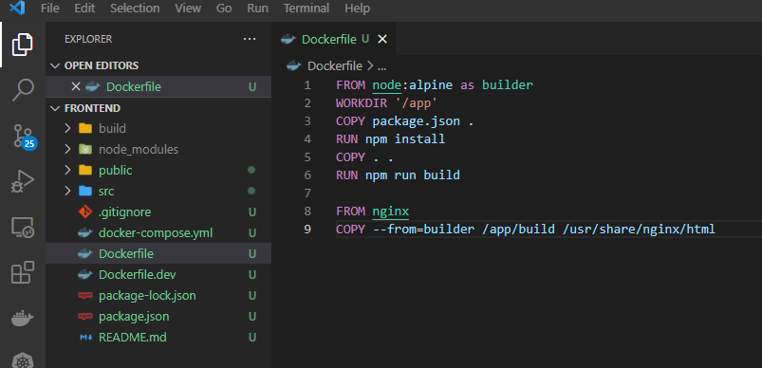
Running Nginx
Notes:
go to docker hub to find Nginx document

Slide 26
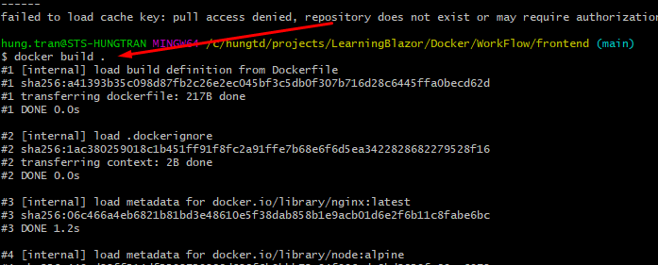
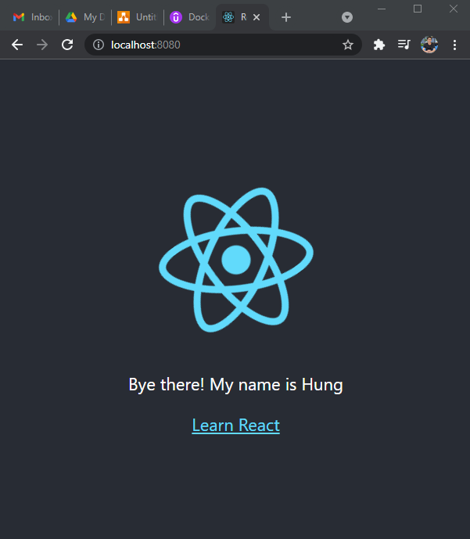
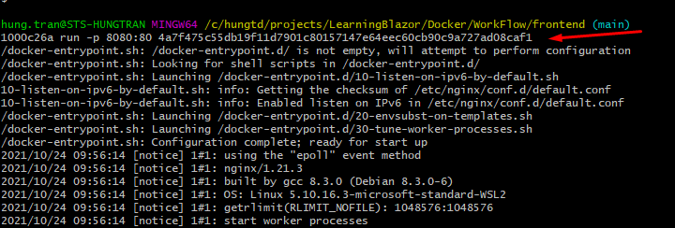
Running Nginx
Notes:
go to docker hub to find Nginx document

Slide 27
THANKS FOR LISTENING

